Slide 1


Generating 3D Faces using Convolutional Mesh Autoencoders
Name: SALIHAJ SARA
Course: DEEP LEARNING FOR ENGINEERING APPLICATIONS
Professor: FERRARI CLAUDIO
Date: FEBRUARY 2026

Slide 2
Introduction
Human faces exhibit large variations in shape due to both identity and facial expressions, but most state-of-the-art 3D face models rely on linear representations that fail to accurately capture the non-linear deformations caused by extreme expressions, which are essential for realistic 3D face modeling.
The authors propose CoMA, a Convolutional Mesh Autoencoder that applies spectral graph convolutions directly on 3D meshes and introduces novel mesh downsampling and upsampling operations to learn a hierarchical multi-scale representation of facial geometry.

Slide 3
CoMA is:
More accurate than PCA-based models (≈50% lower reconstruction error)
More compact (up to 75% fewer parameters)
The authors introduce a new dataset of 20,466 high-resolution 3D face meshes with extreme facial expressions and show that the model can also be used in a variational setting to generate new, realistic 3D faces.
PCA-based models represent facial shapes using linear combinations of principal components, which limits their ability to capture complex non-linear facial deformations.

Slide 4
Related Work
Face Models
Early approaches to 3D face representation are mainly based on linear models, starting from the morphable model introduced by Blanz and Vetter, which uses Principal Component Analysis (PCA) to model variations in facial shape and texture. This paradigm includes widely used models such as the Basel Face Model and other linear models learned from large-scale face datasets. Facial expressions are typically represented using PCA spaces, linear blendshapes, or multilinear extensions, as in models like FLAME, which additionally incorporates head pose through linear blend skinning. While these approaches achieve good performance, their parameters globally influence the face mesh and remain limited in capturing highly non-linear and localized deformations caused by extreme facial expressions. Although some works introduce sparse or hierarchical linear models to better model local details, these methods often lack shared parameters and make it difficult to generate new realistic face shapes by sampling a compact latent space.

Slide 5
CNNs on Meshes
In parallel, several works have explored extending convolutional neural networks to non-Euclidean domains such as graphs and meshes. These approaches include intrinsic and spectral mesh convolutions, dynamic filtering on graphs, and methods that embed mesh surfaces into volumetric grids or planar images to apply standard CNNs. While these techniques successfully generalize CNNs beyond grid-based data, they are often memory intensive or do not provide an efficient mechanism for reducing meshes to a low-dimensional representation. Spectral graph convolutional methods based on the graph Laplacian and Chebyshev polynomial approximations have addressed some of these limitations, but they have rarely been applied directly to full 3D face modeling. CoMA builds upon these spectral methods by combining efficient mesh convolutions with novel mesh downsampling and upsampling operators, resulting in a complete mesh autoencoder capable of modeling complex 3D facial geometry in a compact and hierarchical manner.

Slide 6
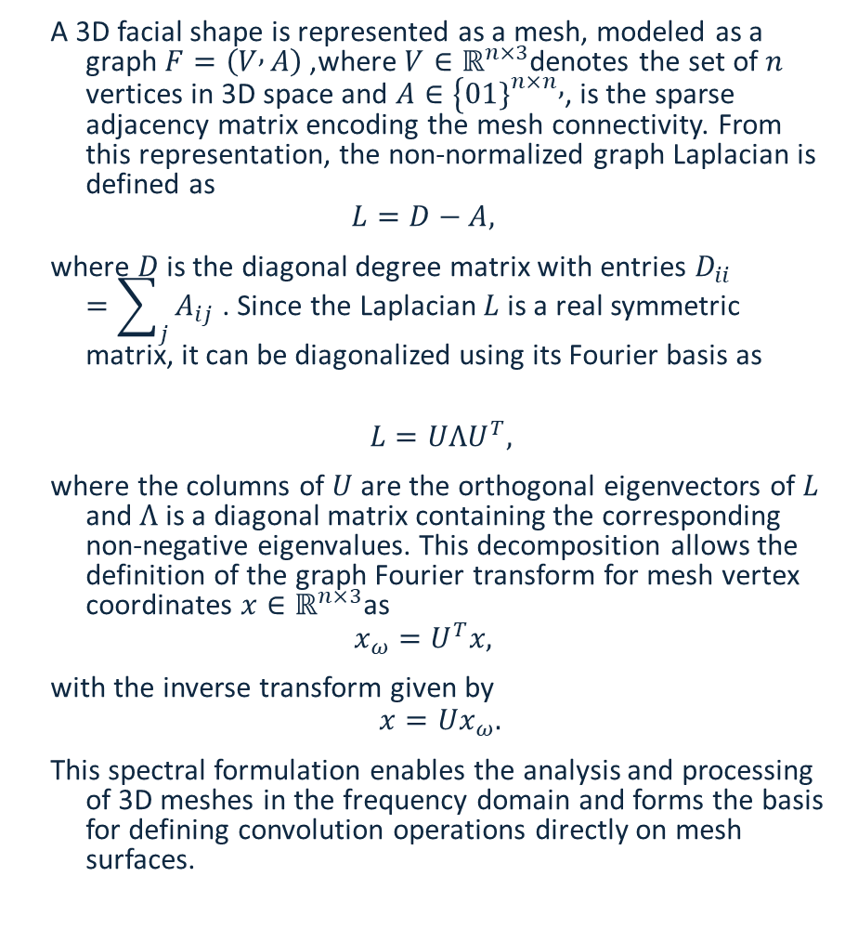
Mesh Operators
A 3D facial shape is represented as a mesh, modeled as a graph $F=\left(V , A\right)$, where $V∈ℝ^{n×3}$denotes the set of $n$ vertices in 3D space and $A∈\{01{\left.\}\right.}^{n×n},$, is the sparse adjacency matrix encoding the mesh connectivity. From this representation, the non-normalized graph Laplacian is defined as
$$L=D−A,$$
where $D$is the diagonal degree matrix with entries $D_{ii}=\sum_{j}{A_{ij}}$. Since the Laplacian $L$is a real symmetric matrix, it can be diagonalized using its Fourier basis as
$$L=UΛU^{T},$$
where the columns of $U$ are the orthogonal eigenvectors of $L$ and $Λ$is a diagonal matrix containing the corresponding non-negative eigenvalues. This decomposition allows the definition of the graph Fourier transform for mesh vertex coordinates $x∈ℝ^{n×3}$as
$$x_{ω}=U^{T}x,$$
with the inverse transform given by
$$x=Ux_{ω}.$$
This spectral formulation enables the analysis and processing of 3D meshes in the frequency domain and forms the basis for defining convolution operations directly on mesh surfaces.

Slide 7
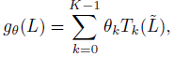
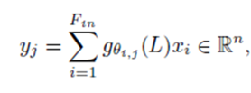
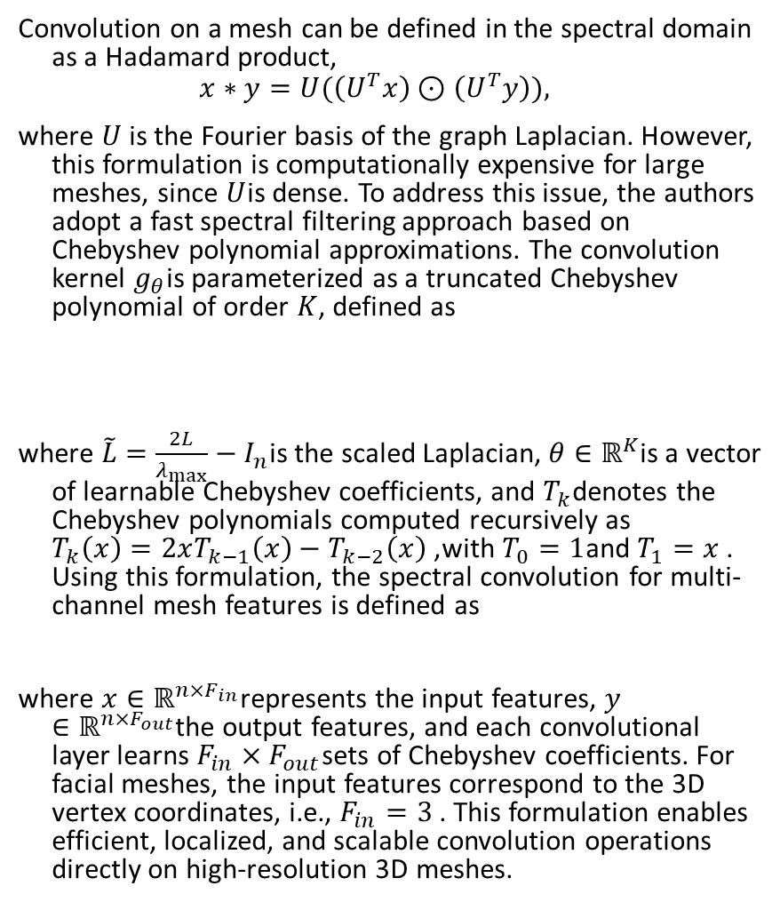
Fast spectral convolutions
Convolution on a mesh can be defined in the spectral domain as a Hadamard product,
$$x∗y=U(\left(U^{T}x\right)⊙\left(U^{T}y\right)),$$
where $U$ is the Fourier basis of the graph Laplacian. However, this formulation is computationally expensive for large meshes, since $U$is dense. To address this issue, the authors adopt a fast spectral filtering approach based on Chebyshev polynomial approximations. The convolution kernel $g_{θ}$is parameterized as a truncated Chebyshev polynomial of order $K$, defined as
where $\tilde{L}=\frac{2L}{λ_{max}}−I_{n}$is the scaled Laplacian, $θ∈ℝ^{K}$is a vector of learnable Chebyshev coefficients, and $T_{k}$denotes the Chebyshev polynomials computed recursively as $T_{k}\left(x\right)=2xT_{k−1}\left(x\right)−T_{k−2}\left(x\right)$, with $T_{0}=1$and $T_{1}=x$. Using this formulation, the spectral convolution for multi-channel mesh features is defined as
where $x∈ℝ^{n×F_{in}}$represents the input features, $y∈ℝ^{n×F_{out}}$the output features, and each convolutional layer learns $F_{in}×F_{out}$sets of Chebyshev coefficients. For facial meshes, the input features correspond to the 3D vertex coordinates, i.e., $F_{in}=3$. This formulation enables efficient, localized, and scalable convolution operations directly on high-resolution 3D meshes.

Slide 8
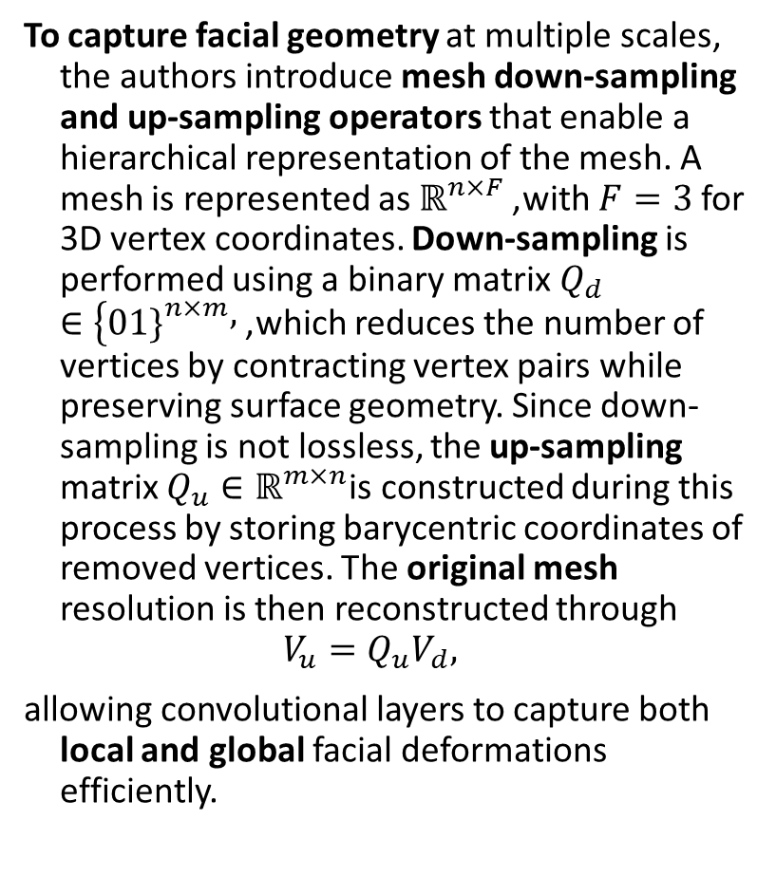
Mesh Sampling
To capture facial geometry at multiple scales, the authors introduce mesh down-sampling and up-sampling operators that enable a hierarchical representation of the mesh. A mesh is represented as $ℝ^{n×F}$, with $F=3$ for 3D vertex coordinates. Down-sampling is performed using a binary matrix $Q_{d}∈\{01{\left.\}\right.}^{n×m},$, which reduces the number of vertices by contracting vertex pairs while preserving surface geometry. Since down-sampling is not lossless, the up-sampling matrix $Q_{u}∈ℝ^{m×n}$is constructed during this process by storing barycentric coordinates of removed vertices. The original mesh resolution is then reconstructed through
$$V_{u}=Q_{u}V_{d},$$
allowing convolutional layers to capture both local and global facial deformations efficiently.

Slide 9
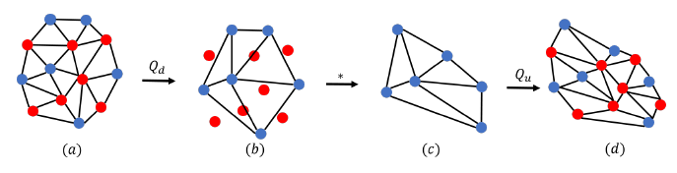
less memory
Figure 1. Mesh sampling operations: (a) the mesh is down-sampled by removing vertices that minimize the quadric error; (b) the barycentric coordinates of the removed vertices are stored with respect to the down-sampled mesh; (c) the reduced mesh is transformed using convolutional operations; (d) the removed vertices are reconstructed at their barycentric locations to recover the original resolution.

Slide 10
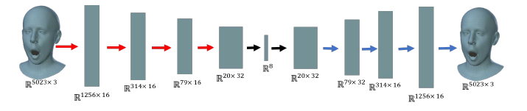
Figure 2. Convolutional Mesh Autoencoder: The red and blue arrows indicate downsampling and up-sampling layers respectively.

Slide 11
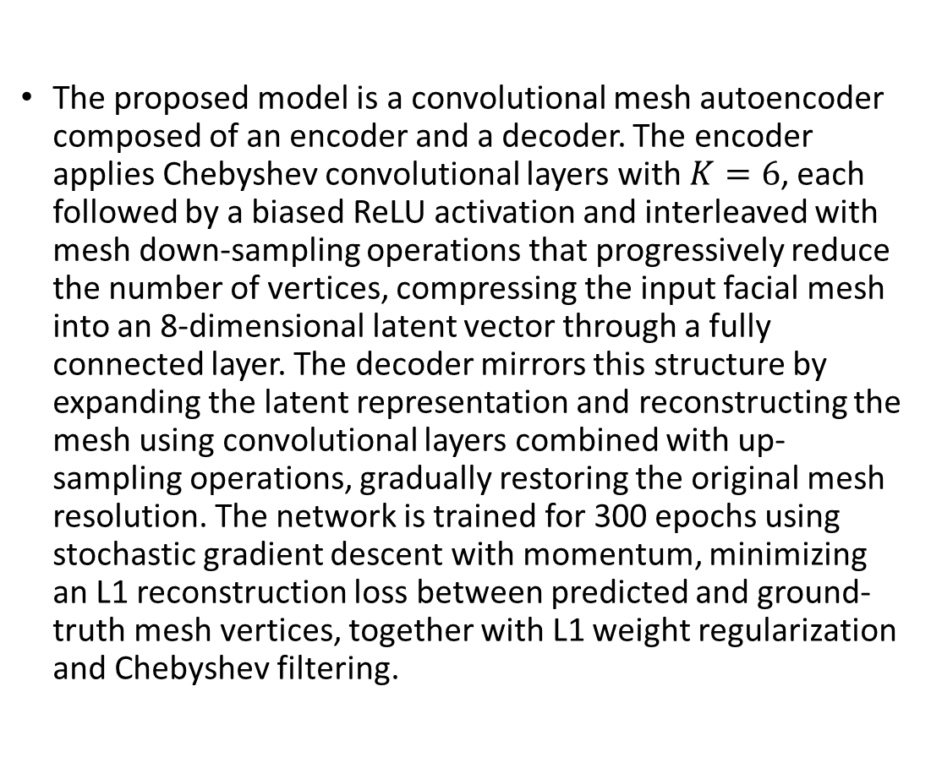
Mesh Autoencoder
The proposed model is a convolutional mesh autoencoder composed of an encoder and a decoder. The encoder applies Chebyshev convolutional layers with $K=6$, each followed by a biased ReLU activation and interleaved with mesh down-sampling operations that progressively reduce the number of vertices, compressing the input facial mesh into an 8-dimensional latent vector through a fully connected layer. The decoder mirrors this structure by expanding the latent representation and reconstructing the mesh using convolutional layers combined with up-sampling operations, gradually restoring the original mesh resolution. The network is trained for 300 epochs using stochastic gradient descent with momentum, minimizing an L1 reconstruction loss between predicted and ground-truth mesh vertices, together with L1 weight regularization and Chebyshev filtering.

Slide 12
Figure 3. Sampling from the latent space of the mesh autoencoder around the mean face j = 0 along 3 different components

Slide 13
Experiments
The effectiveness of CoMA is evaluated on a dataset of extreme facial expressions. The experiments demonstrate that the learned latent space enables the synthesis of new expressive faces, including a variational setting that improves sampling diversity. CoMA is then compared with traditional PCA-based representations in both interpolation experiments, which evaluate reconstruction of expressions similar to the training data, and extrapolation experiments, which test generalization to unseen expressions. Finally, the authors show that replacing the expression space of the state-of-the-art FLAME model with CoMA leads to improved reconstruction accuracy.

Slide 14
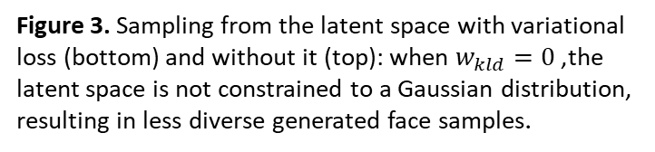
Dataset
The dataset consists of 12 classes of complex and asymmetric extreme facial expressions captured from 12 different subjects, including variations such as bare teeth, cheek contraction, eyebrow motion, and multiple mouth deformations. The data is recorded at 60 fps using a multi-camera active stereo system and includes 20,466 high-resolution 3D face meshes, each originally containing approximately 120,000 vertices. A sequential mesh registration process is applied to reduce the mesh resolution to 5,023 vertices, enabling efficient training while preserving facial geometry.
Figure 3. Sampling from the latent space with variational loss (bottom) and without it (top): when $w_{kld}=0$, the latent space is not constrained to a Gaussian distribution, resulting in less diverse generated face samples.

Slide 15
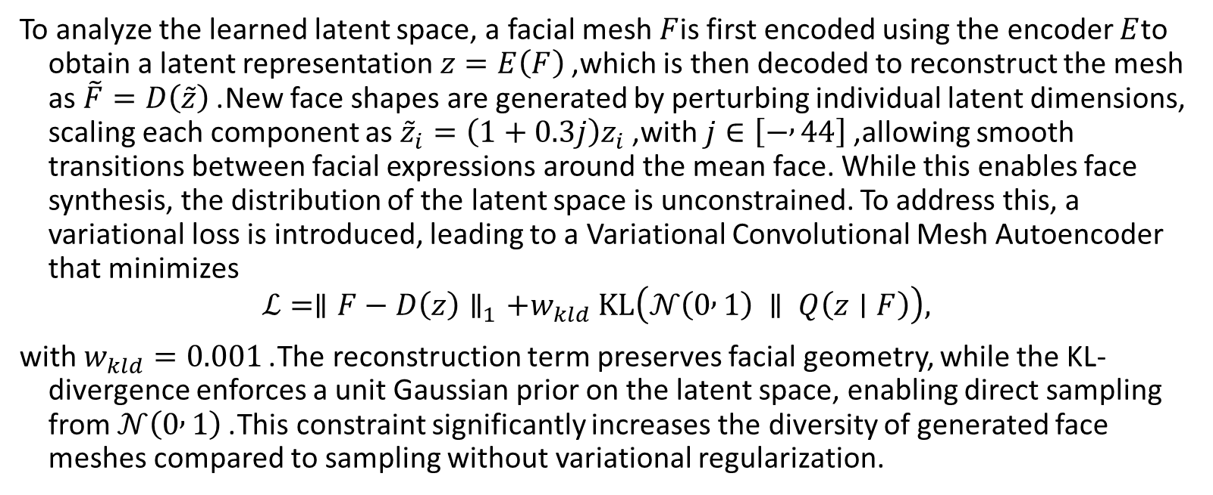
Sampling the Latent Space
To analyze the learned latent space, a facial mesh $F$is first encoded using the encoder $E$to obtain a latent representation $z=E\left(F\right)$, which is then decoded to reconstruct the mesh as $\tilde{F}=D\left(\tilde{z}\right)$. New face shapes are generated by perturbing individual latent dimensions, scaling each component as ${\tilde{z}}_{i}=\left(1+0.3j\right)z_{i}$, with $j∈\left[− , 44\right]$, allowing smooth transitions between facial expressions around the mean face. While this enables face synthesis, the distribution of the latent space is unconstrained. To address this, a variational loss is introduced, leading to a Variational Convolutional Mesh Autoencoder that minimizes
$$ℒ=∥F−D\left(z\right)∥_{1}+w_{kld} KL\left(𝒩\left(0 , 1\right) ∥ Q\left(z∣F\right)\right),$$
with $w_{kld}=0.001$. The reconstruction term preserves facial geometry, while the KL-divergence enforces a unit Gaussian prior on the latent space, enabling direct sampling from $𝒩\left(0 , 1\right)$. This constraint significantly increases the diversity of generated face meshes compared to sampling without variational regularization.

Slide 16
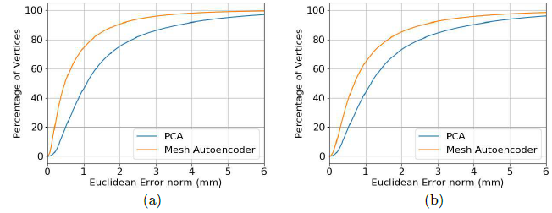
Figure 5. Cumulative Euclidean error between PCA model and Mesh Autoencoder for Interpolation (a) and Extrapolation (b) experiments.

Slide 17
Comparison with PCA Spaces
To evaluate the effectiveness of CoMA, the authors compare it with traditional PCA-based face representations using both interpolation and extrapolation experiments, adopting an equal latent space dimensionality of 8 for a fair comparison.
In the interpolation setting, the model is tested on facial expressions similar to those seen during training, showing that CoMA achieves significantly lower reconstruction error than PCA while using approximately 75% fewer parameters.
Quantitative results demonstrate a reduction of about 50% in reconstruction error, and qualitative comparisons confirm that CoMA produces more realistic reconstructions, particularly for extreme facial expressions.
In the extrapolation experiments, which assess generalization to completely unseen expressions, CoMA is compared against both PCA and the state-of-the-art FLAME model. Across all tested expression sequences, CoMA consistently outperforms both baselines, capturing a higher percentage of vertices within a 1 mm reconstruction error. These results highlight CoMA’s superior ability to generalize beyond the training data and model complex, non-linear facial deformations more effectively than linear approaches.

Slide 18
Figure 6. Comparison with PCA: Qualitative results for interpolation experiment.

Slide 19
DeepFLAME
FLAME is a state-of-the-art 3D face model that represents facial identity and expressions using linear PCA spaces combined with linear blend skinning for head and jaw motion. To improve its reconstruction accuracy, the authors replace the PCA-based expression space of FLAME with the proposed mesh autoencoder, resulting in a new model referred to as DeepFLAME. The comparison focuses exclusively on facial expressions, factoring out head rotations, and evaluates performance using the Euclidean reconstruction error while varying the latent space dimensionality. The results show that DeepFLAME consistently achieves lower median reconstruction error across all tested latent dimensions, and lower mean error for up to 12 latent variables, demonstrating that it provides a more compact and expressive face representation than the original FLAME model.

Slide 20
Figure 7. Comparison with PCA: Qualitative results for extrapolation experiment

Slide 21
Conclusion
CoMA introduces a hierarchical, multi-scale representation for 3D face modeling that combines fast spectral graph convolutions with novel mesh sampling operations in an autoencoder framework. By using locally invariant filters and non-linear activations, the model efficiently captures complex and extreme facial expressions while significantly reducing the number of parameters. Experimental results show that CoMA outperforms state-of-the-art PCA-based models in 3D face reconstruction, achieving lower reconstruction error and better generalization to unseen expressions. In addition, the variational formulation enables the synthesis of diverse and realistic 3D facial shapes by sampling the latent space.
Discussion
CoMA uses the graph Laplacian instead of the Laplace–Beltrami operator, allowing it to capture facial expression deformations that would otherwise be suppressed by isometry-invariant representations. While the model can be applied to other 3D objects, it requires meshes with shared topology and vertex correspondence. As performance is currently limited by the availability of 3D training data, future work will focus on larger datasets and on integrating CoMA with image-based networks for 3D face reconstruction from 2D images.

Slide 22
Thank you!
References: Anurag Ranjan, Timo Bolkart, Soubhik Sanyal, and Michael J. Black
Max Planck Institute for Intelligent Systems
Tubingen, Germany
{aranjan, tbolkart, ssanyal, black}@tuebingen.mpg.de
Acknowledgement We thank T. Alexiadis and J. M´arquez for data aquisition;
H. Feng for rendering the figures; S.Wuhrer for advice on mesh convolutions; and
G. Pavlakos, D. Paschalidou and S. Pujades for helping us with paper revisions.

